Slide 1



Orchestration

Slide 2
(4) Orchestration
(3) Composition
(2) Containerization
(1) Microservice

Slide 3
The Cloud Native Stack
Cloud Native Application Platform
Classical Applications
Cloud Native App
How to run (containerized) applications on a cluster? How to automate standard operations procedures?
Cluster Operating System
Cluster Orchestrator
Applications
How to provide the right resources for container execution? (e.g. for high utilization)
Cluster Scheduler
Container
Cluster Virtualization
Resources
How to decouple from physical hardware?

Slide 4
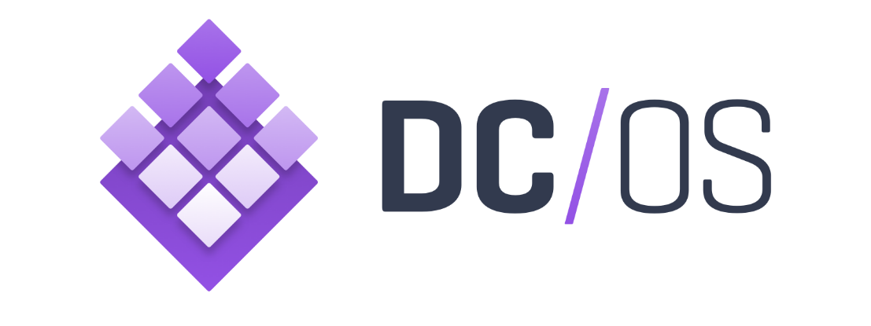
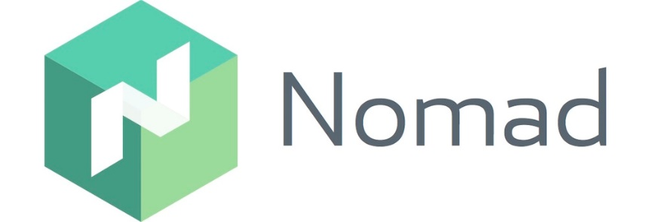
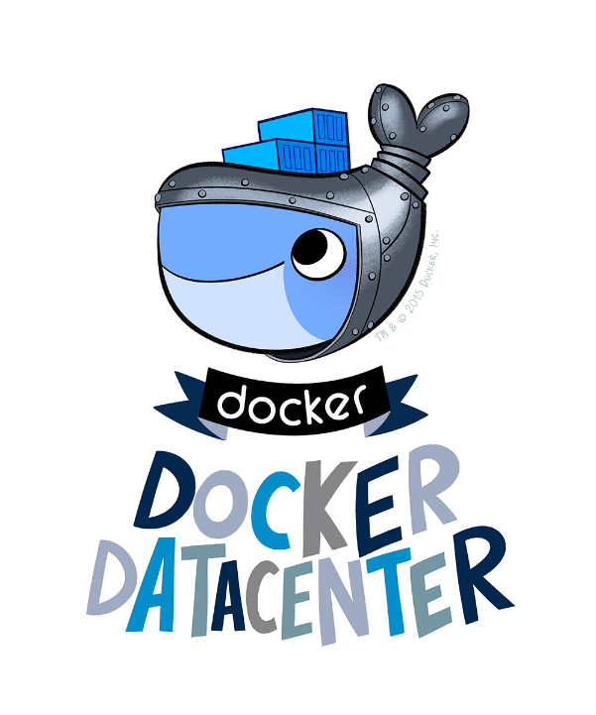

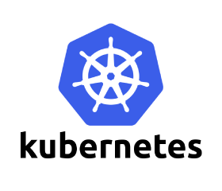


Available Cluster Operating Systems
+ Distributions

Slide 5

Sneak Preview: DC/OS
Metadata
Website: https://dcos.io
Initiator: Mesosphere Inc.
In production use at: Verizon and Mesos-only at Apple, Twitter, AirBnb, ...
Basic abstractions: Application, Application Group, Deployment
How to get a running cluster
https://dcos.io/install
Where to start
https://dcos.io/docs
https://mesosphere.github.io/m arathon/docs

Slide 6
DC/OS Architecture

Slide 7
DC/OS: Building Blocks
Clients
DC/OS UI
DC/OS CLI
DC/OS REST API
Kafka (Messaging)
Jenkins (CI)
Orchestrators
…
Marathon (Microservices)
Chronos (Batch Jobs)
Spark (Dataservices)
Cassandra (Database)
HDFS (File System)
Scheduler
Mesos
Cosmos / Universe (Package Manager)
DC/OS IAM (IAM)
Vault (Secrets)
Minuteman, Navstar, Spartan, Mesos-DNS, Marathon-LB, Admin-Router, Bouncer (Networking)
OS Services
Notes:
Often also includes addidtional services like:
Package Manager
Private Container Registry
Multi-Tenancy
Cross-DC-Federation
Credentials / Certificate Management
Roles & Rights Management
Basic Cloud Native Application Platform: Service Discovery (DNS, VIP) and API Gateway (LB)

Slide 8
Cluster Scheduling
Cluster Orchestrator
Applications
Cluster Scheduler
Container
Cluster Virtualization
Resources

Slide 9
Problem Space
Compute
Tasks
?
Compute
Resources

Slide 10
The Datacenter as a Computer: A Cluster should look alike a single computer from the outside.
Cluster
Scheduler
The Datacenter as a Computer: An Introduction to the Design of Warehouse-Scale Machines, 2009, Luiz André Barroso und Urs Hölzle

Slide 11
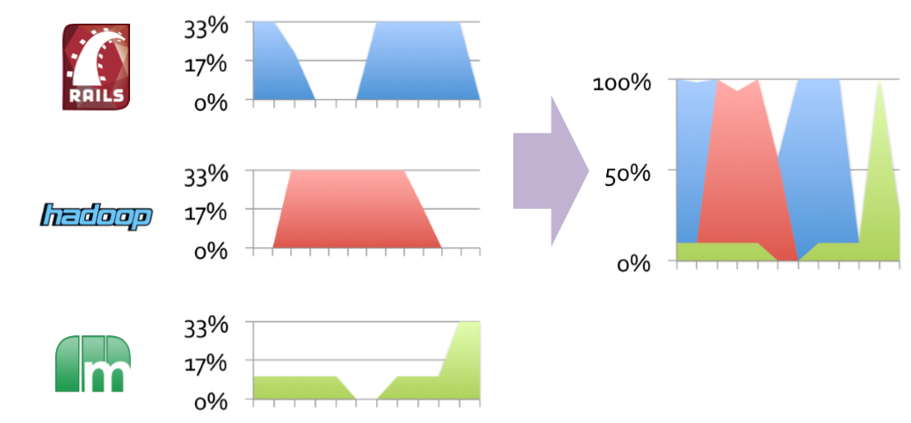
The Resource Utilization can be Improved by Dynamic Partitioning. This is the very Job of Cluster Scheduler.
Cluster state
Static Partitioning
Dynamic Partitioning
-- Re-Scheduling --
-- Re-Scheduling --
-- Re-Scheduling --
Higher utilization ➔ less resources required ➔ saves money ➔ happy manager
time

Slide 12
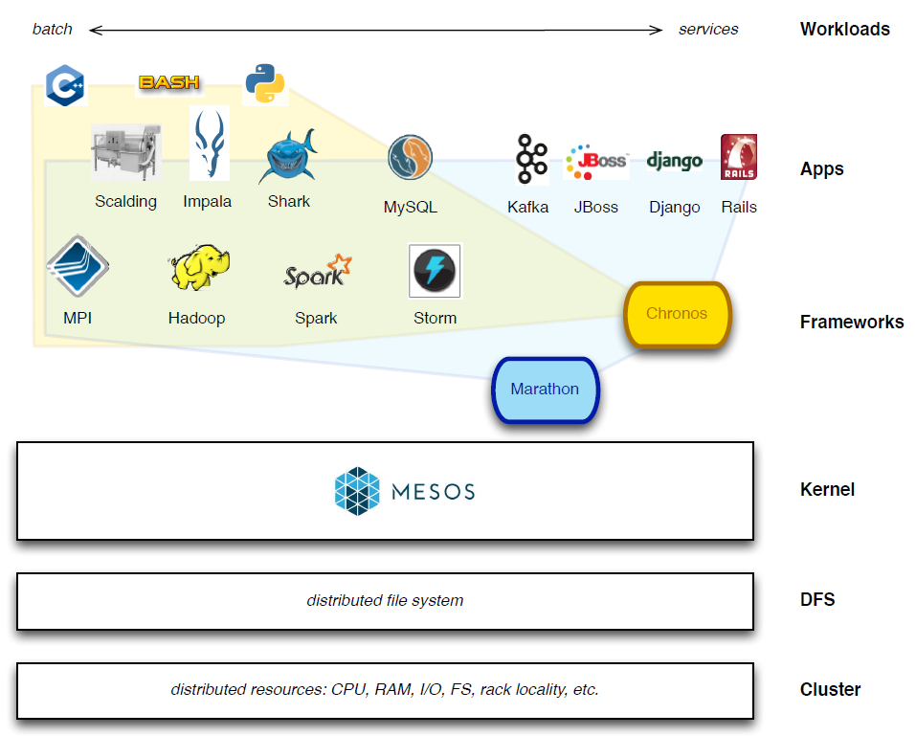
Apache Mesos
Originated at UC Berkeley AMPLab
Initial work by Ben Hindman
First release back in 2009
Open Source project (APL 2.0)
Quelle: https://www.typesafe.com/blog/play-framework-grid-deployment-with-mesos
Notes:
Der Nutzen entsteht durch die auf Mesos basierenden Frameworks.

Slide 13
Cluster Orchestration
Cluster Orchestrator
Applications
Cluster Scheduler
Container
Cluster Virtualization
Resources

Slide 14
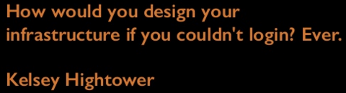
Cluster Orchestration: Far Beyond Composition. Automating Standard Operations Procedures.
run (composition)
rollback (composition)
deploy
re-deploy
scale
configure
monitor
kill
…
DevOps API
Application Blueprint
container scheduling
auto-scaling
auto-healing
storage orchestration
network orchestration
deployment workflows
container logistics
Cluster Orchestrator
Cluster Scheduler
Running Application

Slide 15
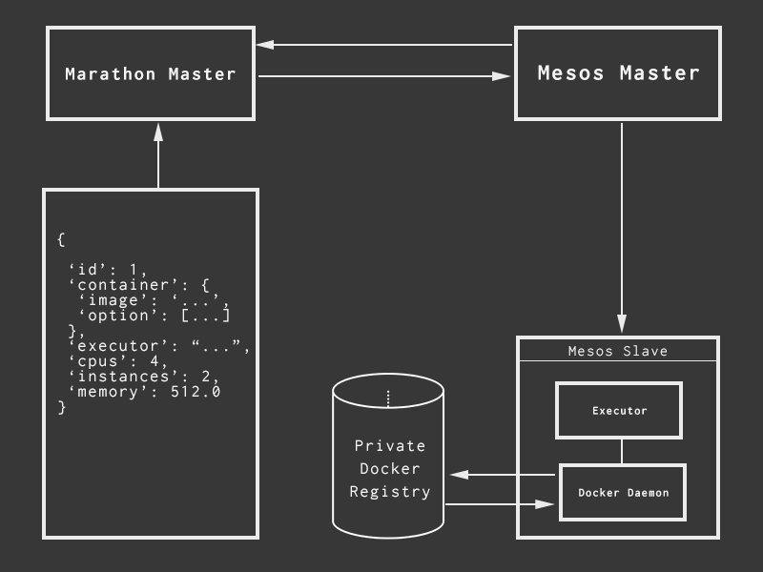
The Marathon Cluster Orchestrator.

Slide 16
A Docker Compose Blueprint
consul:
image: gliderlabs/consul-server:0.6
command: "-data-dir /tmp/consul -bootstrap-expect 1 -server -ui -node=consul-server"
environment:
- GOMAXPROCS=10
ports:
- "8300:8300" #server - Server RPC address. Default 8300.
- "8500:8500" #http - The HTTP API, -1 to disable. Default 8500.
- "8600:8600/udp" #dns - The DNS server, -1 to disable. Default 8600.
zwitscher-chuck:
build: ../../services/zwitscher-app-chuck
ports:
- "12340:12340" #chuck REST service
links:
- consul

Slide 17
An equivalent Marathon Blueprint: The Microservice
{ "id": "zwitscher-chuck", "cpus": 1, "mem": 256, "disk": 0, "instances": 1, "container": { "docker": { "image": "adersberger/zwitscher-app-chuck:1.0.0-SNAPSHOT", "forcePullImage": true, "network": "HOST" } }, "ports": [12340], "env": { "PORT": "12340", "CONSUL": "consul.marathon.mesos:8500", "CONFIG_ENV" : "zwitscher“ }, "args": ["-Xmx256m"], "healthChecks": [ { "protocol": "HTTP", "port": 12340, "path": "/metrics/ping", "intervalSeconds": 10, "timeoutSeconds": 10, "maxConsecutiveFailures": 3 }], "constraints": [["hostname", "UNIQUE"]] }
Application ID
Required resources
Number of application instances (can also be scaled afterwards)
The Docker image to instantiate
The Docker networking mode
The ports to be exported (also port mapping supported)
Environment variables e.g. endpoint names
Container startup arguments
Health checks
Placement constraints

Slide 18
An equivalent Marathon Blueprint: Consul
{ "id": "consul", "cpus": 1, "mem": 256, "disk": 0, "instances": 1, "cmd": "/bin/consul agent -server -ui -advertise=$HOST -config-dir=/config -data-dir=/tmp/consul -bootstrap-expect=1 -node=consul-server -client=0.0.0.0", "container": { "docker": { "image": "gliderlabs/consul-server:0.6", "forcePullImage": true, "network": "HOST" } }, "ports": [8300, 8301, 8302, 8400, 8500, 8600], "env": { "GOMAXPROCS": "10" }, "healthChecks": [ { "protocol": "HTTP", "port": 8500, "path": "/v1/status/leader", "intervalSeconds": 10, "timeoutSeconds": 10, "maxConsecutiveFailures": 3 }]}

Slide 19
Network Orchestration

Slide 20
Docker (and Marathon) Networking Modes
:81
:82
1.2.3.4
1.2.3.4
DNS
IPAM
:80
:80
localhost
localhost
5.6.7.9
5.6.7.8
Host
Bridge
Overlay Network / User Defined Network
Bound port
Network interface
Guest
Host
The one and only solution for non-trivial clusters as the other nodes are constraining scheduling.
https://mesosphere.github.io/marathon/docs/ports.html
https://docs.docker.com/engine/userguide/networking
Notes:
Vagrant erlaubt nur das Forwarding auf Ports > 1024. Das liegt an Betriebssystem-Einschränkungen.
Gilt für TCP. UDP muss dediziert beschreiben werden.
Docker Host: Manuelle Anpassung IPTables notwendig um Ports am Host anzulegen
https://www.safaribooksonline.com/library/view/vagrant-up-and/9781449336103/ch04.html
http://www.dasblinkenlichten.com/docker-networking-101-host-mode/

Slide 21
The Problem with Multiple and Ephemeral Instances: How to find them? Which one to choose?
bar1
?
foo
bar2
bar3
Service Discovery?
Load Balancing?
https://docs.mesosphere.com/1.8/usage/service-discovery

Slide 22
The Solutions within DC/OS: Virtual IPs (VIPs) and DNS.
bar1
VIP
146.10.47.11
foo
magic
bar2
bar3
https://docs.mesosphere.com/1.8/usage/service-discovery/load-balancing-vips/overlay-networks
bar1
bar.marathon.mesos
DNS
magic
bar2
foo
bar3
https://mesosphere.github.io/mesos-dns/docs/naming.html

